Slide 1
Ethical Issues for Computing Professionals Involving Bitcoin and Similar Technologies
By Rohan Maharjan
CSCI 2098, Ethics and Prof. Issues in Communication

Slide 2
Overview
Introduction
History of Bitcoin and Ethereum
Example of an Ethical Issue
Analysis of the Issue
Roles of Computer Scientists
Conclusion
References

Slide 3

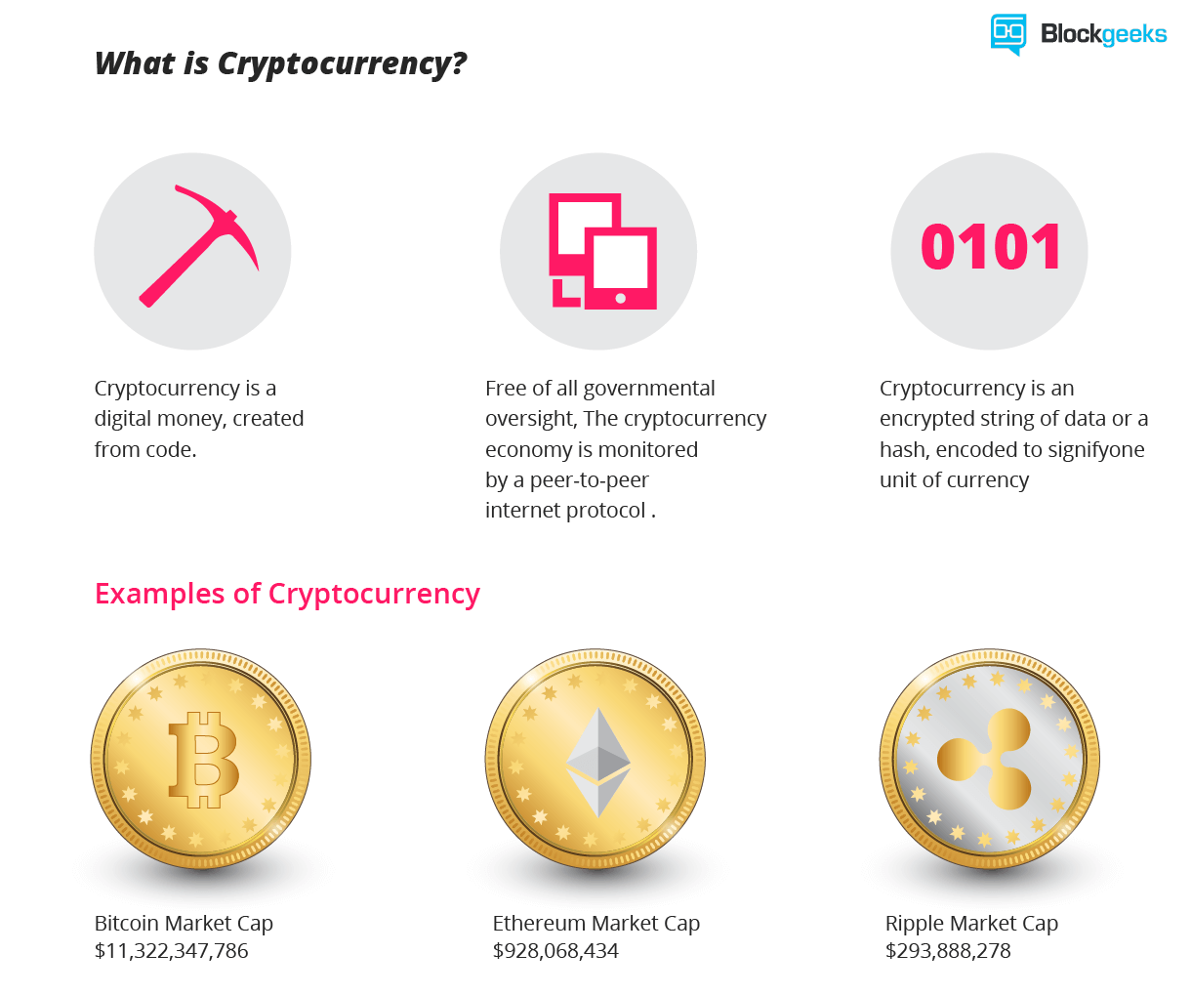
Cryptocurrency
Source: Blockgeeks Inc

Slide 4
History of Bitcoin
Developed by Satoshi Nakamota
Intended to create a decentralized electronic cash system
Ended up creating Bitcoin on January 2009

Slide 5
Creation of Ethereum
Developed by Vitalik Buterin
Russian programmer in Bitcoin Magazine
Argued that Bitcoin needed scripting language
Lack of agreement led to development of Ethereum in January 2014

Slide 6
Ethical issue: DAO Attack
What is DAO?
Maintains Ethereum cryptocurrency
DAO Got Hacked
A bug in the DAO code
Stole 55 million dollars
Consequences
Hard forked the blockchain
Trust in Cryptocurrency decreased resulting in decrease in value

Slide 7
Who was Ethically Responsible for the Loss?
Hacker
Stole the money
Ethereum Foundation
Chose to hard fork the blockchain causing the market to crash
DAO Contributors
Wrote the complex and faulty code
Supports Deontological perspective (Baase 29)
Against Utilitarianism perspective (Baase 30)
Prioritized DAO funds over the investor’s money
Against Locke’s perspective (Baase 31)
Bug caused the actual hack
Against Utilitarianism perspective(Baase 30)

Slide 8
Roles of Computer Scientists
Allocate time for testing code
Simple code for better testing
Use Standard Best Practices

Slide 9
Conclusion
No clear person that is 100% responsible for the loss
Shared blame across multiple people
Computer programmers are highly responsible to secure the code

Slide 10
References
Baase, S. (2009). A gift of fire: Social, legal, and ethical issues in computing. Upper Saddle River (New Jersey): Prentice-Hall.
Gladden, M. E. (2015). Cryptocurrency with a Conscience: Using Artificial Intelligence to Develop Money that Advances Human Ethical Values. Annales. Etyka W życiu Gospodarczym,18(4). doi:10.18778/1899-2226.18.4.06.
Alex, Magni, T., Magni, T., @eulisesralph, E. R., @eulisesralph, E. R., @abhijitroy, A. R., & @abhijitroy, A. R. (1969, March 01). What is Ethereum Classic? Ethereum vs Ethereum Classic. Retrieved from https://blockgeeks.com/guides/what-is-ethereum-classic.
Gutierrez, D., Gutierrez, D., @sashabakcht, S., @sashabakcht, S., @probeshdargmail, R. K., Khan, R., . . . Nirmalya Sengupta. (1969, December 11). Learn What is Cryptocurrency: The Most Comprehensive Guide Written. Retrieved from https://blockgeeks.com/guides/what-is-cryptocurrency.

Slide 11
Thank you for listening!
Any Questions?

